Slide 1

Actor Pattern & Akka & more..
Another way of programming

Slide 2

The problem that hunts everyone and everywhere…
thread
Memory
thread
Shared
State
thread
thread

Slide 3
Usual Java resolves that in many ways…
But… Usual programmers have so many ways to do that wrong anyway…
volatile int state;
public synchronized accessThat(…) AtomicInteger state; Lock lock = new ReentrantLock();
StampedLock lock = new StampedLock(); ConcurrentHashMap Collections.synchronizedMap(map) CompletableFuture<String> completableFuture = CompletableFuture.supplyAsync(() -> "Hello") .thenCombine(CompletableFuture.supplyAsync(() -> " World"), (s1, s2) -> s1 + s2);
Stream.of(mama, papa, me).filter(..).map(...)...-BTW why I mention that here?

Slide 4
And…
import javax.ejb.Stateful; @Stateful
public class AccountBean implements Account and… import com.amazonaws.services.lambda.runtime.RequestHandler;
public class Handler implements RequestHandler

Slide 5
Testing multithreaded apps
https://www.baeldung.com/java-testing-multithreaded

Slide 6
What we want to achieve???????

Slide 7
Allow only to 1 thread to access a critical object

Slide 8
How to do all that much better?
The idea was firstly introduced in 1973…in some theoretical works
It has its very successful implementation in Erlang language The language used to manage telcom infra in Ericson.

Slide 9
This is the usual call sematics..
Uncontrolled
And
Unmanaged
Threads
Object
State

Slide 10

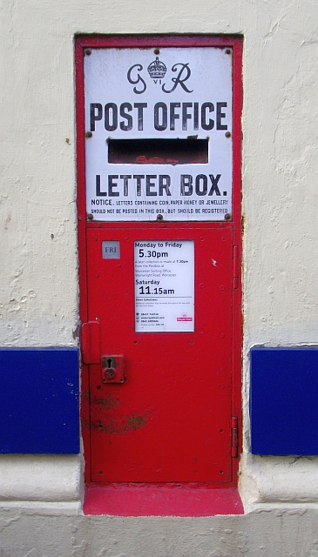
Let’s change the call semantics:
Object becomes an Actor And actors “talk” to each other Actors do not invoke a method
Actors send message instead into the Message Box of an Actor
Thread (only 1 in a time) takes the message
from the bottom of the Message Box and pushes it into the Actor.
Actor interacts only with 1 message at any
moment of time and
able modify ONLY its (actor’s) private state.
Object(Actor)
State

Slide 11
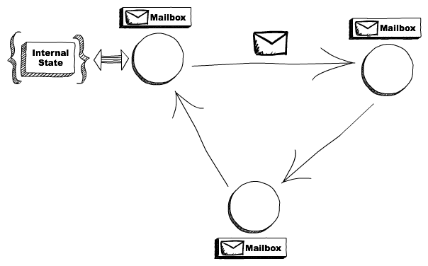
So , it looks like that…
actor
actor
actor
No shared state between actors
Functions asynchronously
All about message passing for communication
- Only way to share/change state is through this message passing

Slide 12
What that resolves….
No concurrency management required (forget everything synchronized and Atomic..)

Slide 13
But ..there is MUCH, MUCH, MUCH more in it…
… now hard even to imagine
HOW MUCH!!!
And the rest describes powers of AKKA

Slide 14
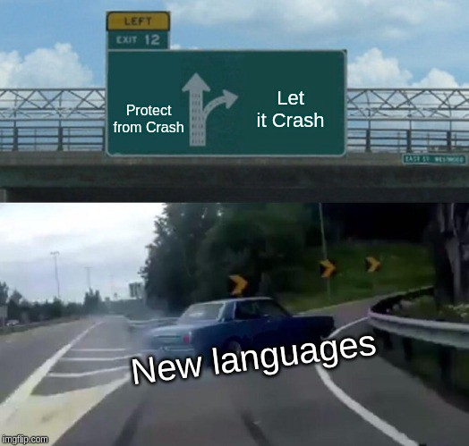
New strategies in complex systems

Slide 15
Imagine such an abstract world:
SV
SV
SV

Slide 16
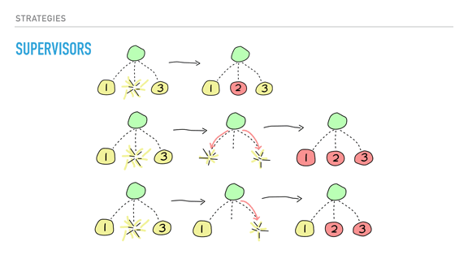
Fail fast – is all about supervision…

Slide 17
Why crashing is so good…?
Because of the price of the new actor creation (low)
Because of ability to resurrect this failed actor anywhere
Because of design clarity: my crash management is NOT MY JOB, it is always my supervisor’s Job.
Because even if I crashed, data is safe.(actors allowed to maintain persistent state somewhere = Journaling)
Data Center 1
New York
Data Center 2
Tokyo
Node
Node
Node
A1
A2
Node
Node
A2’
A2’

Slide 18
Routing strategies – all kinds are available…
A
https://doc.akka.io/docs/akka/current/typed/routers.html
Router
A
A
A

Slide 19
Message boxes – all kinds are available…
A
https://doc.akka.io/docs/akka/current/typed/mailboxes.html
Message
Box
A

Slide 20
Dispatchers – all kinds are available…
A
https://doc.akka.io/docs/akka/current/typed/dispatchers.html
Message
Box
Dispatcher – it is the configured thread pool
Also,
You can combine them
In different ways
A

Slide 21
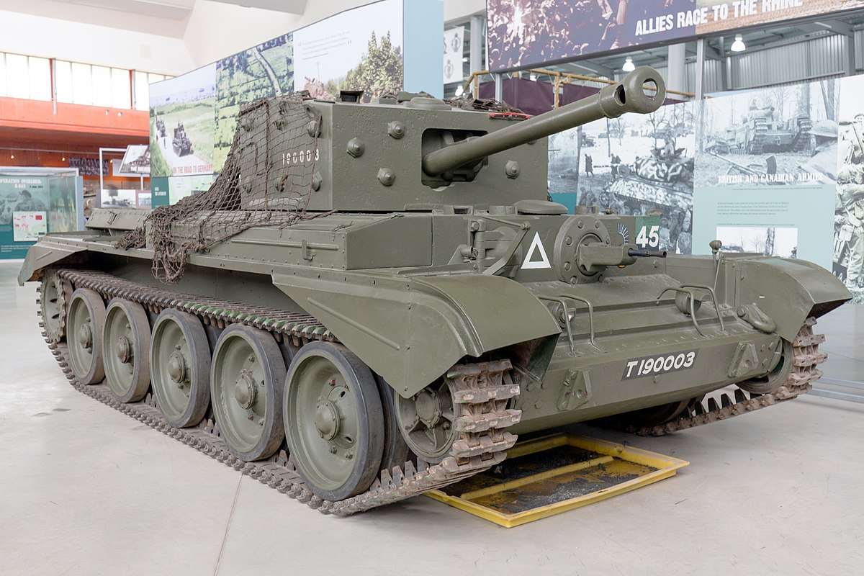

Example
https://github.com/peterkovgan/akka-quickstart-scala_8004/blob/master/src/main/scala/com/peter/actors/game/Game.scala
https://github.com/peterkovgan/akka-quickstart-scala_8004/blob/master/src/main/scala/com/peter/actors/game/ComputerFSM.scala
Default config:
https://doc.akka.io/docs/akka/current/general/configuration-reference.html
Actor System
Battle Field
Battle Field
shell
shell
Tank
Tank
shell
Comp(FSM)
Comp(FSM)
shell
shell
Tank
shell
shell
Comp(FSM)
shell
shell
shell
X - meters
- distance, where shells report they crossed it…
shell
shell

Slide 22
Clustering…actors could work in ELASTIC clusters
Data Center 1
New York
Data Center 2
Tokyo
Node
Node
Node
A1
A2
Node
Node
A2’
A2’

Slide 23
Clustering…shards – actors could migrate from node to node – sender should not be aware
Data Center 1
New York
Data Center 2
Tokyo
A1
A2
A2’

Slide 24
What Akka able to do?
With akka you can build very powerful frameworks/platforms. And from those platforms you can build distributed, scalable, resilient applications.
App1
App1
Your framework
App1
App1
Akka
App2
App2
App2
App2

Slide 25
I done something myself few years ago..
Kafka
Solace
RabbitMQ
Tcp/Ip
Abstract Flow
Source
Iris
(cluster)
Arke
(cluster)
Hera
(cluster)
Kali
(cluster)
Router
Kafka
Cassandra
Oracle
Secret Chinese
DB
Target
Arke

Slide 26
Project “Lagom” – Microservices by Play and Akka..
Lagom is a Swedish word for something like “optimal, just enough”
Play!
Akka!
Lagom

Slide 27

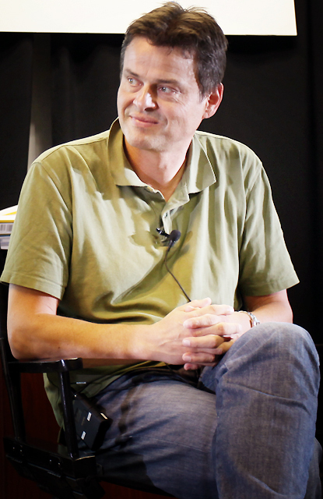


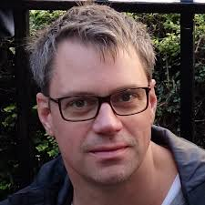


A bit of history…
(2011-2013)
Scala
Akka
Sbt
Play!
2013..
Lagom
(reactive microservices framework)
Martin Odersky
Jonas Bonér
Paul Phillips
Pocker player

Slide 28
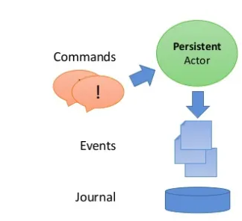
Actors - persistence
“Event Sourcing”: Persistent state preserved as a series of events (sort of a queue)
On write – event added to the tail
On read –all events read and the state formed In MS world this has analogy in the popular CQRS pattern: https://martinfowler.com/bliki/CQRS.html

Slide 29
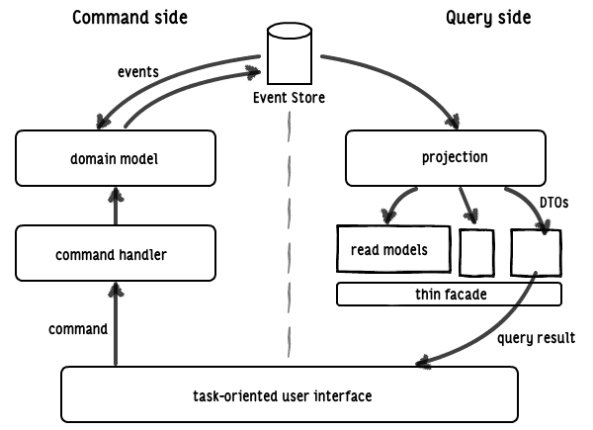
CQRS
Cassandra, Kafka
“Journal”
MS1
MS2
thin facade

Slide 30
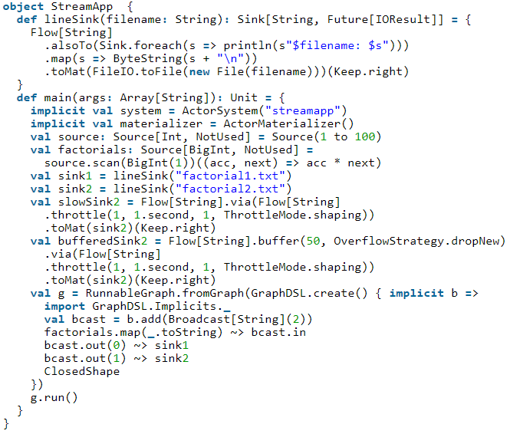
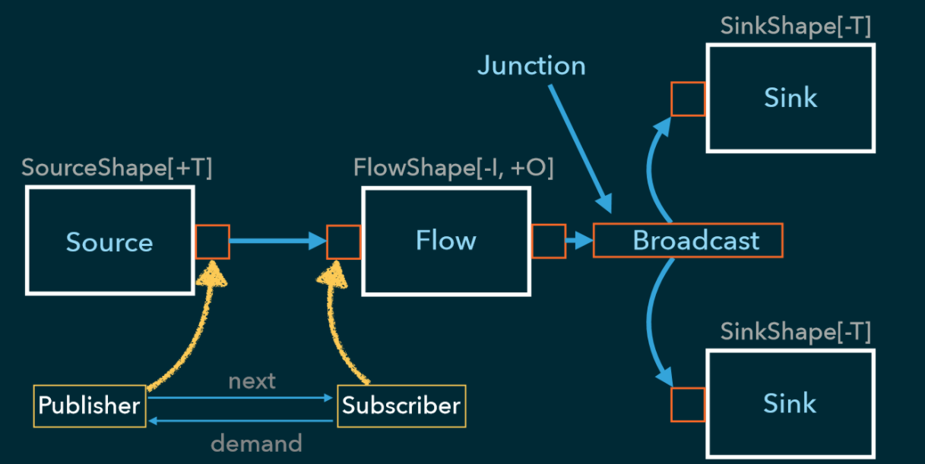
Akka streaming
https://www.reactivemanifesto.org/
https://blog.softwaremill.com/how-not-to-use-reactive-streams-in-java-9-7a39ea9c2cb3
https://doc.akka.io/docs/akka/current/stream/index.html

Slide 31
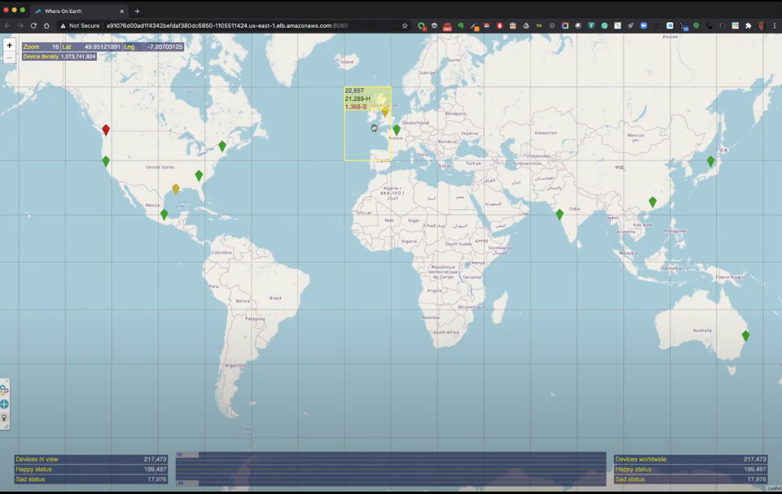
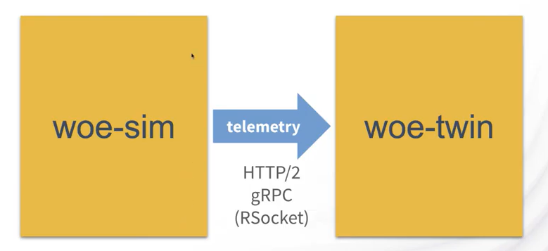
Demo time….Akka in IoT world…Microservices…
https://youtu.be/otowhwYtjH0?t=318
-actors serve as physical devices endpoints
https://youtu.be/otowhwYtjH0?t=518
-zooming into IoT devices
https://youtu.be/otowhwYtjH0?t=1093
-architecture
https://youtu.be/otowhwYtjH0?t=1388
- developed on a laptop, runs in AWS

Slide 32

Where go from here…
https://academy.lightbend.com/
https://www.scala-lang.org/

